Slide 1

BIG DATA ANALYTICS IN HADOOP ENVIRONMENT

Slide 2




How can Big Data Analytics plays its role in improving government agencies operations?
Isolation of data
Gov agencies
Data
(SD and USD)
Cyberthreats exist on government networks 16 days BEFORE being detected
Big Data Analytics
Platform
Descriptive, Predictive and Prescriptive Analytics
Troubleshooting, root-cause analysis,
identify and predict security threats
Predictive Forensics
Predicting threats

Slide 3
BIG DATA PLATFORM

Slide 4
EXPECTED BIG DATA INFRASTRUCTURE
ETL
Data
Warehouse
Analytics
Traditional Data Warehouse
SD
TECHNOLOGY
(Platform, Programming Models, Applications)
SD = Structured Data
USD = Unstructured Data
Data Warehouse/Data mart
Business Intelligence/Analytics
SD
Big Data Platform
Hadoop
Big Data Apps
USD

Slide 5
CONFIGURATION FOR BIG DATA PLATFORM

Slide 6
TABLE OF CONTENTS
1. INTRODUCTION
2. REFERENCES CONFIGURATION
3. RECOMMENDATION CLUSTER
4. DATA ANALYSIS
5. DATA SECURITY
6. CONCLUSION

Slide 7
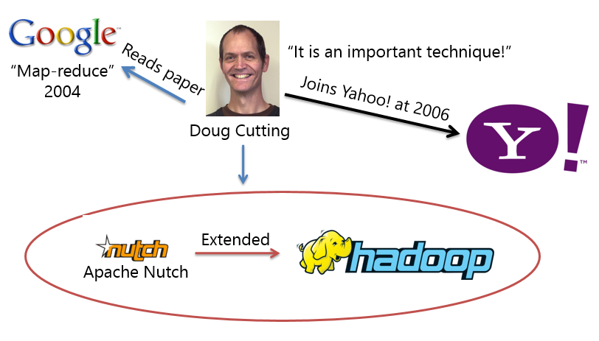
INTRODUCTION
History of Hadoop
Notes:
Riniy

Slide 8

What is Hadoop?
Pioneered by Google and Yahoo!
Open source project
Written in Java
Optimized to handle:
Massive amounts of data through parallelism
A variety of data (structured,unstructured, semi-structured)
Uses inexpensive commodity hardware
Reliability provided through data replication
Great performance for extreme volumes of data
Batch oriented
Large streaming, or sequential processes
Data can be appended but not updated
Generate business intelligence related reports
Not for OLTP, OLAP, or DSS
Not intended to be a replacement to traditional RDMS
Notes:
Developed by Doug Cutting while at Google. Hadoop is named after his son’s toy elephant.

Slide 9











INTRODUCTION
Apache Hadoop
An open source software framework
Hosted by Apache Software Foundation
For storing data & running apps on clusters
For managing Big Data (BD)
Components
Hadoop
Common
HDFS
MapReduce
YARN
Pig
Oozie
HBase
Flume
Spark
Hive
Cassandra
Zookeeper
HCatalog
Chukwa
Scoop
Solr
Ambari
Solr
Notes:
riniy

Slide 10
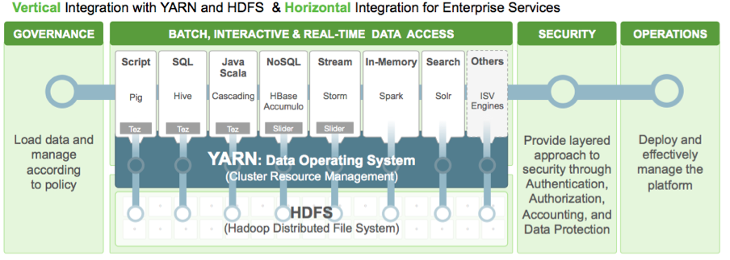
INTRODUCTION
Hadoop Architecture

Slide 11
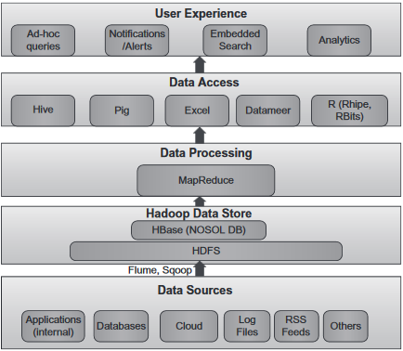
HADOOP TECHNOLOGY STACK

Slide 12
Hadoop Platforms
Platform | Application Domain
Hive | MapReduce based large data set analysis
Pig | MapReduce based large-scale parallel implementations
HBase | Distributed database that supports structured data storage for large tables
Mahout | Machine learning and data mining library
Spark | Large scale, real time data processing and scalable machine learning applications.
Storm | Real time analytics, online machine learning, continuous computation and distributed extraction transformation loading (ETL) process
Flume | Efficient collection, aggregation and transfers large amount of data
Zookeeper | Reliable and efficient distributed coordination in distributed applications
Cassandra | A scalable multimaster database with single points of failure

Slide 13
Hadoop Architecture
Hadoop Distributed File System (HDFS)
HDFS is a distributed file system written in Java
Has a high degree of fault tolerance
Designed to run on commodity hardware
HDFS consists of master/slave architecture where a single Name Node is the master and a number of Data Nodes as the slaves
Name Node manages the file system namespace operations like opening, closing and renaming of files and directories and also controls access to files by clients.
Data Nodes are in charge of serving read and write requests from the file system’s clients, block creation, replication and deletion upon instructions from the Name Node

Slide 14
Hadoop Architecture
MapReduce
MapReduce is a programming model for processing and generating large datasets in computer clusters.
MapReduce uses the concept of parallel programming
Implemented in master/slave architecture where a single Job Tracker is the master node and several Task Trackers as the slaves.
The job tracker is in charge of scheduling the jobs’ tasks on the slaves, monitoring the performance of the slaves and re-executing the tasks experiencing any kind of failure and acts like an interface between the user and Hadoop framework.
Whereas, the task trackers are responsible for executing the tasks as guided by the job tracker (master) and manage the data flow between the two phases

Slide 15
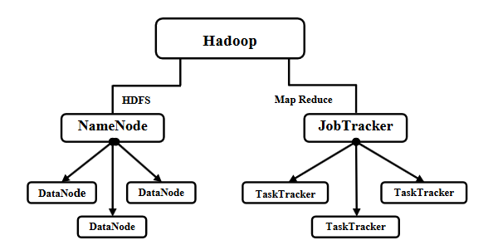
Hadoop Architecture

Slide 16
Comparison of Hadoop Techniques with other Techniques
 | HDFS | GFS
Platform | Cross-platform | Linux
Written In | Java | C, C++
License | Apache | Proprietary
Developer(s) | Primary: Yahoo! And also the open source community | Google
Node Division | Name Nodes & Data Nodes | Master Nodes & Chunk Servers
Hardware Utilization | Commodity hardware or servers
 | MapReduce | RDBMS
Size of data | Petabytes | Gigabytes
Type of data | Structured, semi-structured and unstructured | Structured
Scaling | Linear | Non-linear
Fault Tolerance | High | Low
Integrity | Low | High

Slide 17

INTRODUCTION
Computing Power
Scalability
Benefits
of Hadoop
Flexibility
Low
Cost
Fault
Tolerance

Slide 18
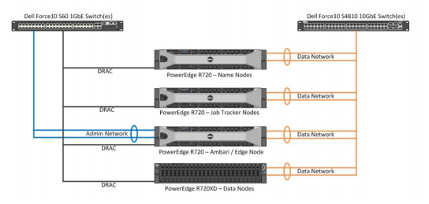
CONFIGURATION DIAGRAM

Slide 19
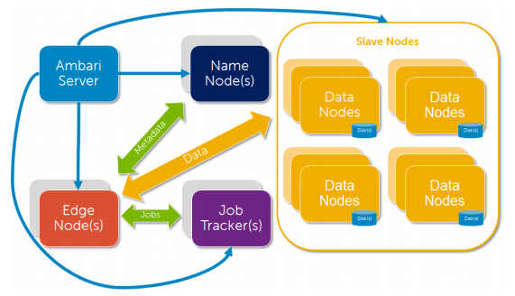
Big Data Cluster Logical Diagram

Slide 20
RECOMMENDED CLUSTER
 | Recommended Cluster | prices
Name Node | 1 | RM 20,000
Job Tracker | 1 | RM 20,000
Data Node | 3 | RM 60,000
Ambari Management Node | 1 | RM 20,000
1 GbE switches | 1 | RM 1,800
10 GbE Switches | 1 | RM 55,000
Rack Units | 24U | RM16,000
Monitor + KVM switch & UPS |  | RM 12,000
 | TOTAL | RM 204,800

Slide 21
Big Data Environment
Data Node
installed and running
(Hadoop and Apache Components)
A web browser
with an Internet
connection
Hortonworks
NameNode
installed and running
(Ambari)
Administrative
priviledges to run
tools
Big Data
Environment
Hortonworks
ODBC driver
installed and
configured
Sentiment
Data files
(USE-CASE)
MS Excel 2013 ProPlus or
SAS, Tableau or
any visualize tool
Notes:
linda

Slide 22
USE-CASE (Customer segmentation)
Sample Use-Case Experiment
1.
2.
Sample 1: Visualize Website Clickstream Data
Sample 2: Analyzing Social Media and Customer Sentiment
Step 1: Download and Extract the Sentiment Tutorial Files
Step 2: Load Twitter Data into the Hortonworks Sandbox
Step 3: Copy a Hive Script to the Sandbox
Step 4: Run the Hive Script to Refine the Raw Data
Step 5: Access the Refined Sentiment Data with Excel
Step 6: Visualize the Sentiment Data Using Excel Power View
Step 1: View and Refine the Website Clickstream Data in Hortonworks
Step 2: Access the Website Clickstream Data with Excel
Step 3: Visualize the Website Clickstream Data Using Excel Power View
Notes:
linda

Slide 23
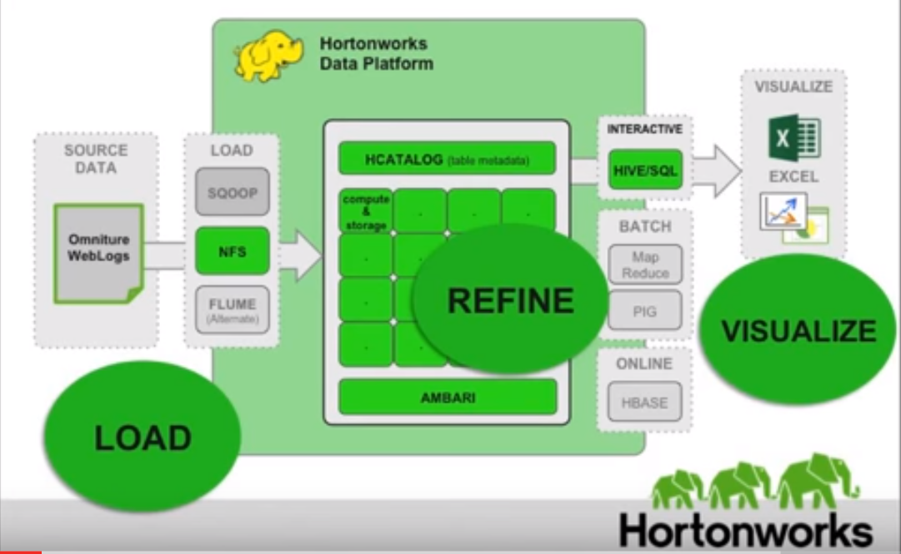
DATA ANALYSIS
1
Sample 1: Visualize Website Clickstream Data
Analysis with Website Clickstream
Clickstream
info trail user leaves behind while visiting a website (semi-structured log files)
used for path optimization, basket analysis, next product to buy & allocation of website resources
Focuses on a path optimization use case specifically on how to improve the website by
reducing bounce rates and improve conversion
Data Analysis Using Hadoop &
Hive Tool
website data files were loaded into
the HDFS
3 tables – omniture logs, products &
users created via HCatalog component
Hive Query – view the clickstream data
& refine via hive query script (editor)
BI (Power View in MS Excel 2013)
– analyze and visualize clickstream
data generated through Beeswax
Hive (UI) in HDFS
Notes:
riniy

Slide 24
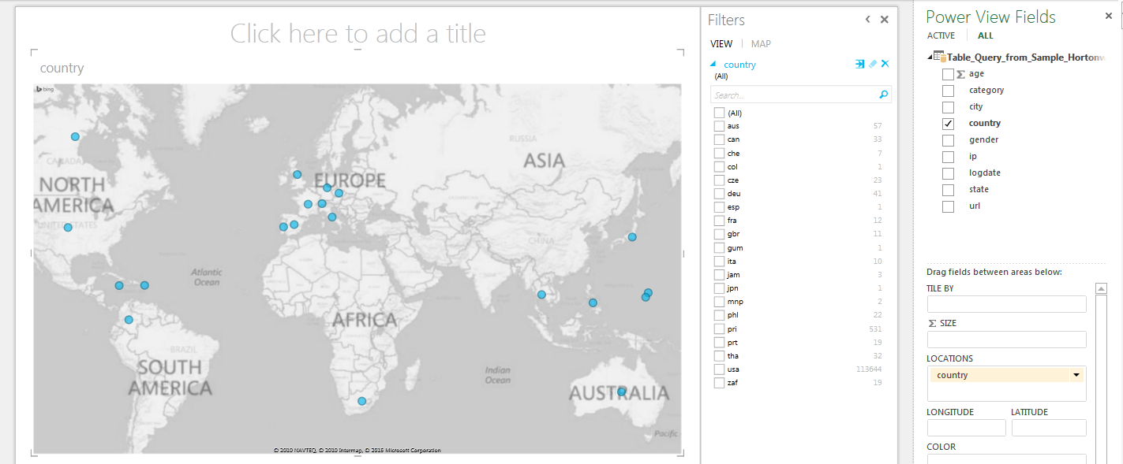
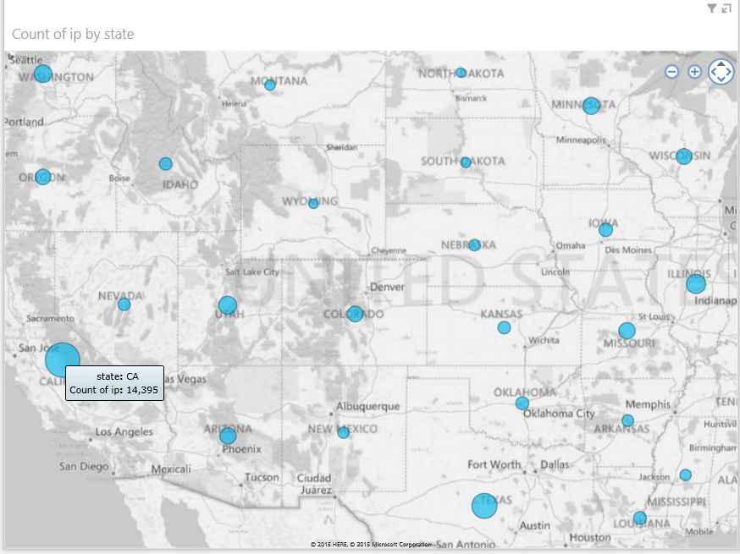
DATA ANALYSIS
Data visualization
helps to optimize the website and improve the business sale and values
contained 3 components – field area, filter & size
Based on the sample, data analysis on the clickstream data categorised by location (country/state), product category, age and gender, target customer segment and identify a web pages with the highest bounce rates.
Map Visuals of Data Clickstream by State (United States)
Map Visuals of Data Clickstream by Country
Notes:
riniy

Slide 25
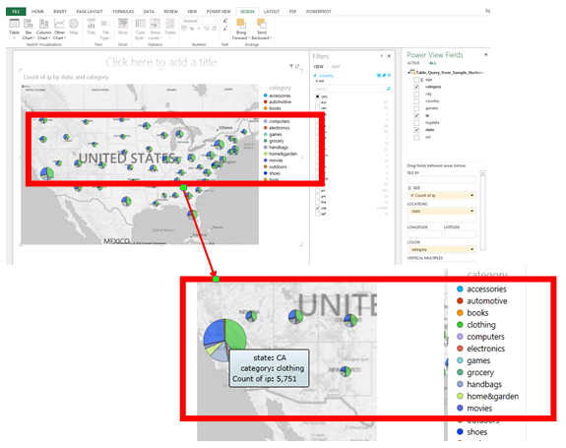
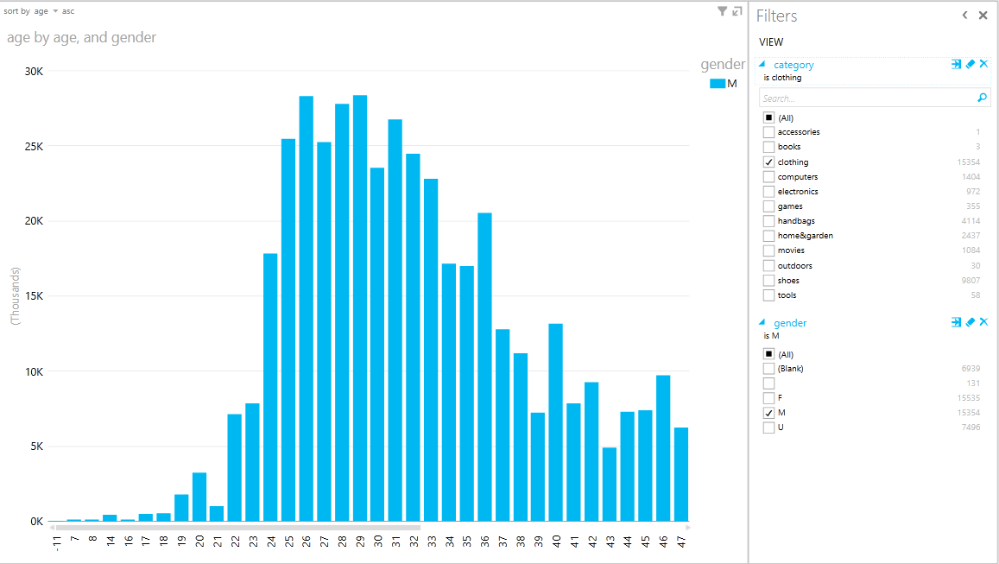
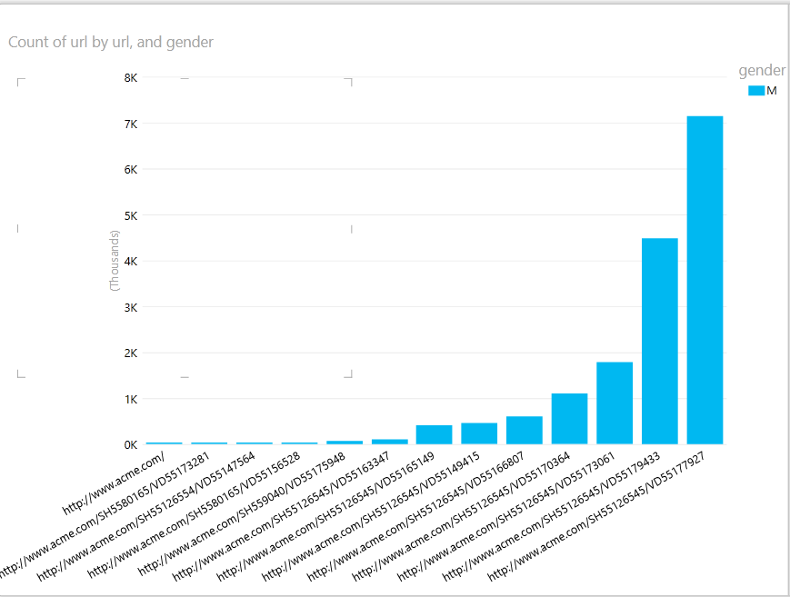
DATA ANALYSIS
Customer Population Chart on Clothing Data by Age and Gender
Map Visual the Highest Number of Visitor by Product Categories and Colors
Count of URL
in Ascending Order
Notes:
riniy

Slide 26
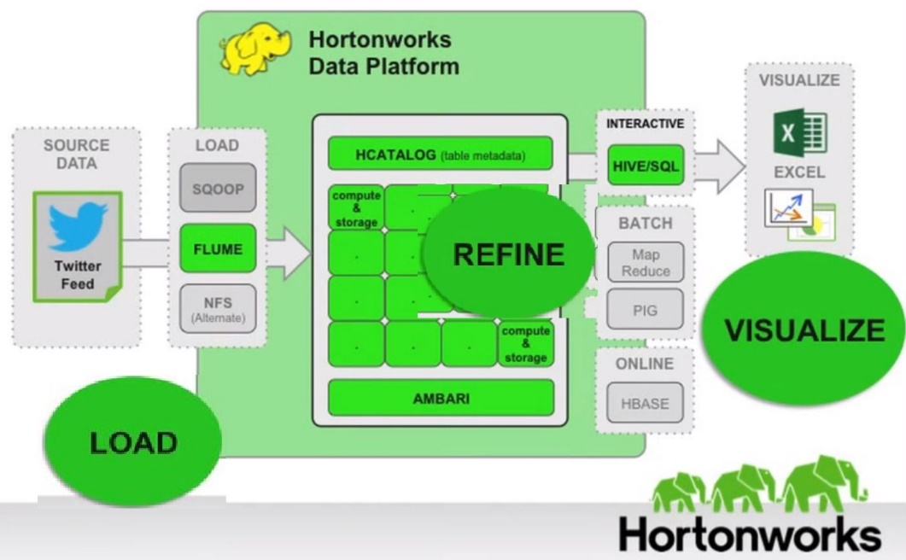
DATA ANALYSIS
2
Sample 2: Analyzing Social Media and Customer Sentiment
Sentiment Analysis with Twitter Feeds
Twitter.com – a popular microblogging website, each tweet contained 140 characters in length
Tweets – to express emotion on a particular subject
Polarity – Positive, Negative and Neutral
Sentiment data – unstructured data represents opinions, emotions & attitudes contained in sources
such as social media posts, blogs, online product reviews & customer support interactions
Focuses on a product launch on Twitter Data at public sentiment during the days leading
up to and immediately following the recent release of the movie Iron Man 3
Sentiment Data Analysis Using
Hadoop & Hive Tool
Raw data is generated from twitter in
JavaScript Object Notation (JSON)
format using twitter API 1.1
Sentiment data (stream Twitter feeds)
were captured using Flume and then
loaded into the HDFS
Hive – create table tweetsbi, refine raw
data & view in HCatalog
Import into MS Excel 2013 with ODBC
BI (Power View in MS Excel 2013)
– analyze and visualize sentiment data
Notes:
linda

Slide 27

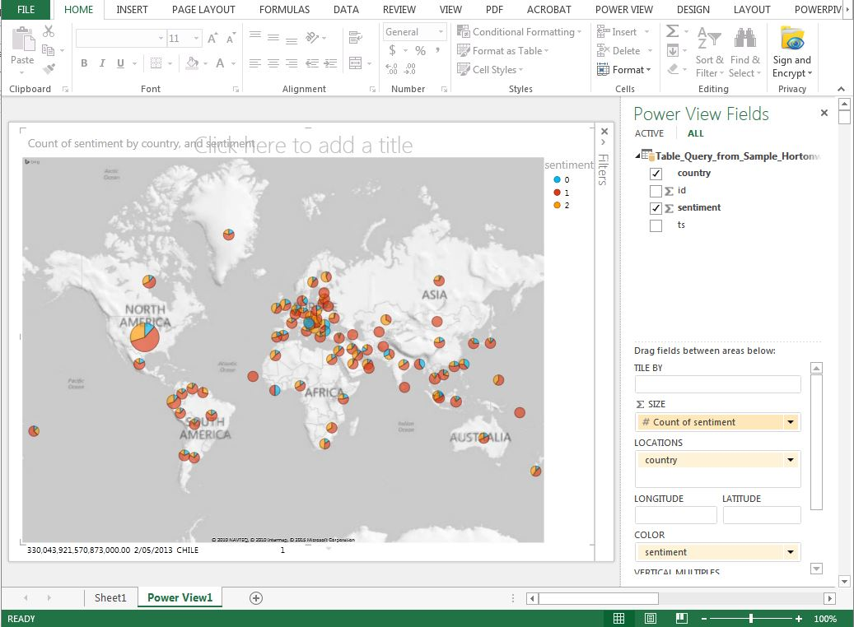
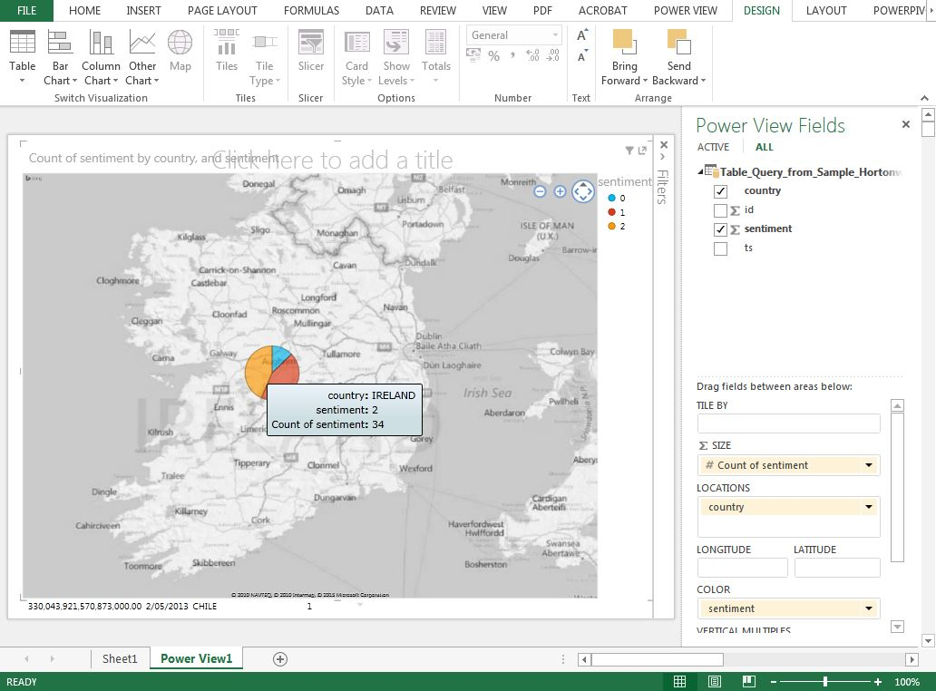
DATA ANALYSIS
Data analysis categorised by country and colors
The map displays the sentiment data by color –
Positive Sentiment in Ireland
Sentiment by Country and Colors
Notes:
linda

Slide 28
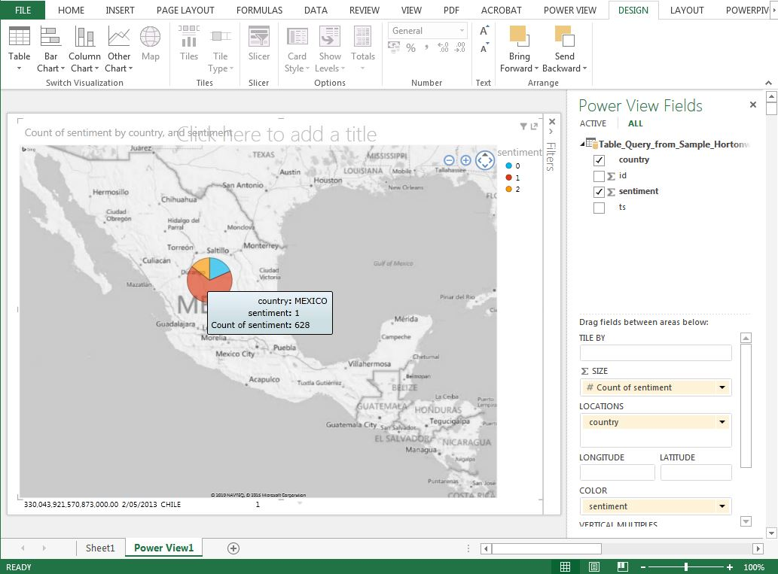
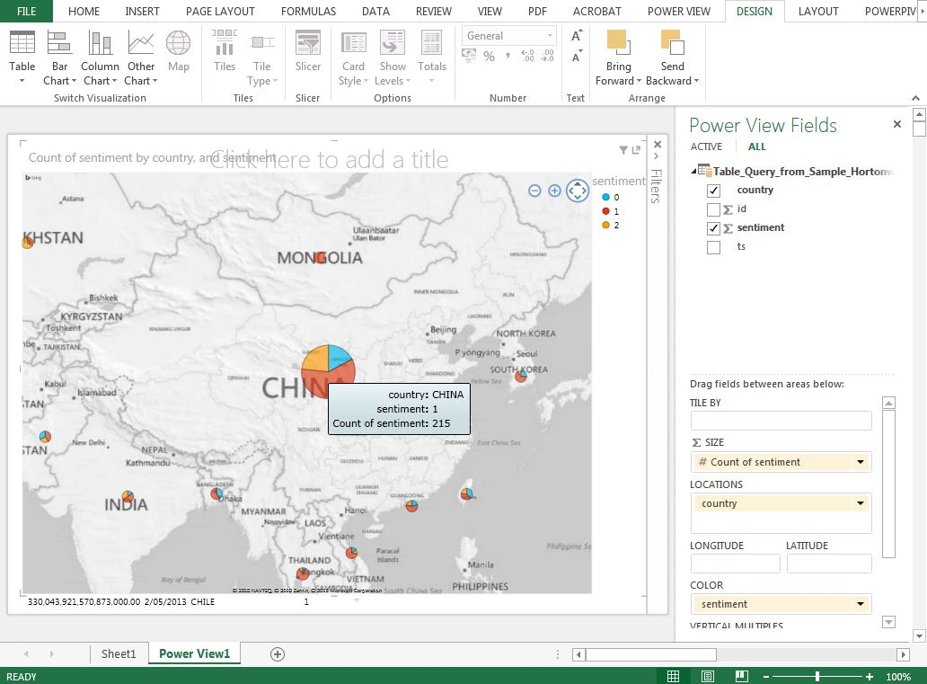
DATA ANALYSIS
Neutral Sentiment in China
Negative and Neutral Sentiment in Mexico
Notes:
linda

Slide 29
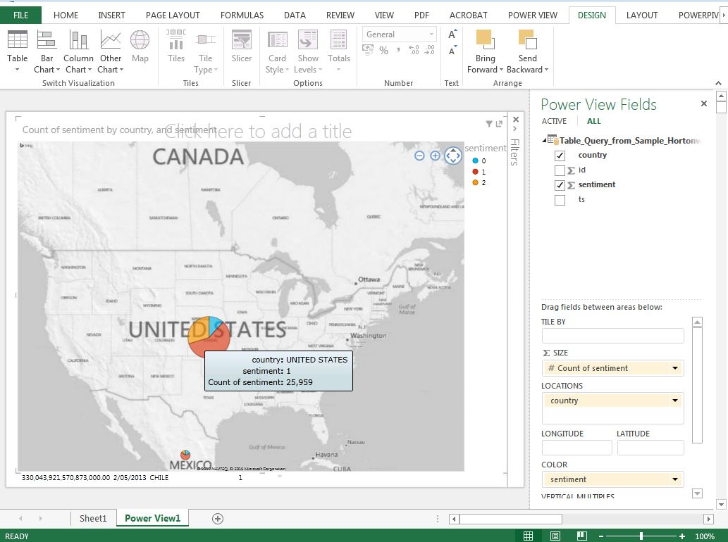
DATA ANALYSIS
Neutral Sentiment in US
Data analysis shows:
visualization of Twitter sentiment data for the release of Iron Man 3
This info will be useful for planning marketing activities for any future Iron Man movie releases
Notes:
linda

Slide 30
DATA ANALYSIS
Optionality Constraints
and Default Values
(prevents an attribute
from taking Null,
or missing values)
Domain/
Data
Constraints
1
2
Format Constraints
(specifies correctness
of format)
3
Valid Value Constraints
(some data have well defined
valid values)
Notes:
linda

Slide 31
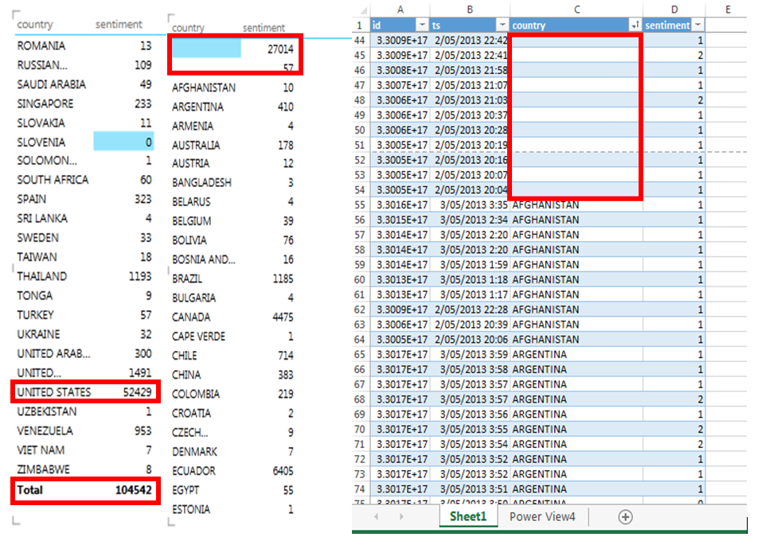
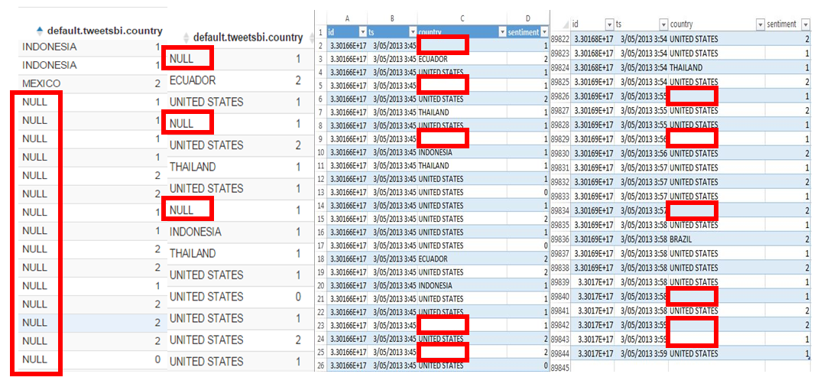
DATA ANALYSIS
Domain/Data Constraints
Optionality Constraints
and Default Values
(prevents an attribute from taking
Null, or missing values)
1
Demo 2: Optionality Constraints for Country Records
Demo 2: Null/Blank Tweet Values for Country Records
Notes:
linda

Slide 32
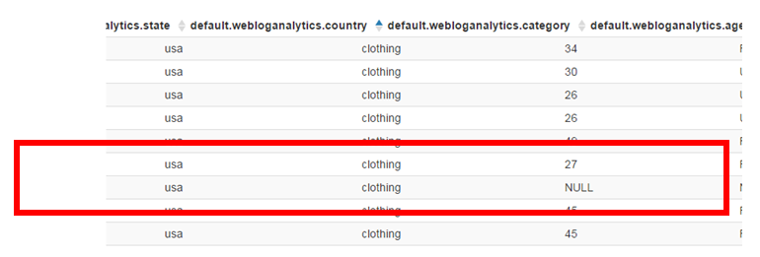
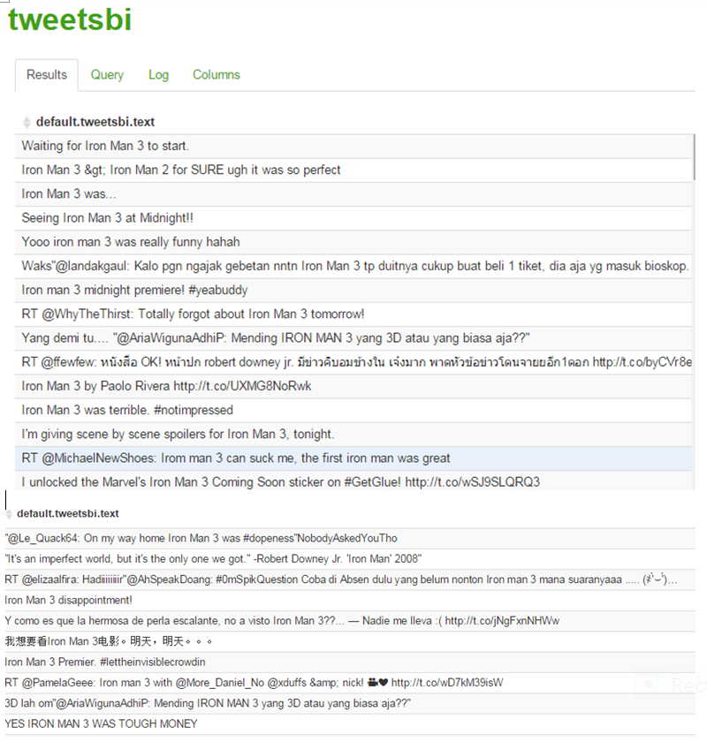
DATA ANALYSIS
Domain/Data Constraints
Format Constraints
(specifies correctness of format)
2
Demo 2: Format Constraints for Text Records
Demo 1: Format Constraints for Birth Date (Age) Records
Notes:
riniy

Slide 33
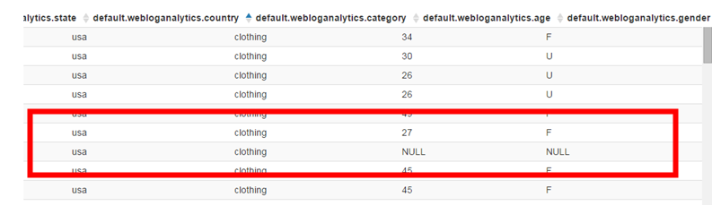
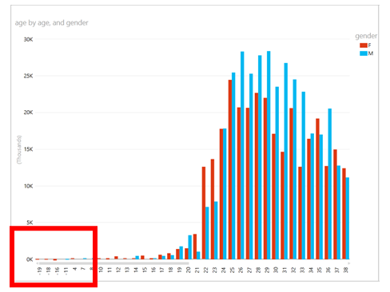
DATA ANALYSIS
Domain/Data Constraints
3
Valid Value Constraints
(some data have well defined
valid values)
Demo 1: Invalid Value Data for Gender
Demo 1: Valid Value Constraints for Gender Records
Notes:
riniy

Slide 34
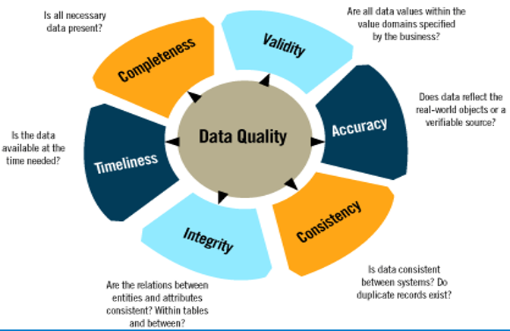
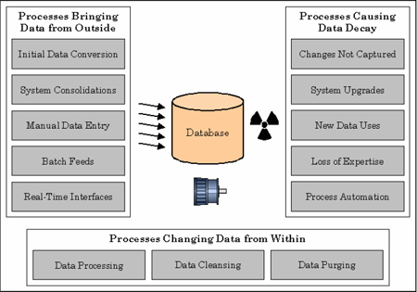
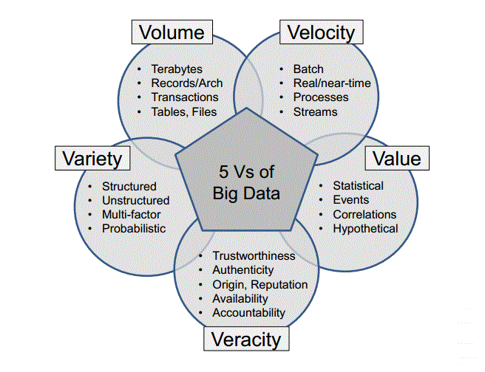
DATA SECURITY
Data Quality
(DQ)
Processes Affecting DQ
Big Data (BD)
Properties
Notes:
linda

Slide 35
DATA SECURITY
Hadoop Data Security Issues
File Upload Vulnerabilities
Best Practices/Suggested Solutions
Validate the file extension
Encrypt connection SSL
Allow certain extension files only
Both server-side & client-side validation
Allow non-executable files only
(to prevent Hadoop execute malicious
scripts/harmful files uploaded)
DoS Attacks
To prevent
DoS attacks,
we should
impose limits
on the number
of files a user
can upload
in a 24 hours
period as well
as limiting
the file sizes.

Slide 36
DATA SECURITY
Analytical &
Technical
Challenges
1
Issues Related
to the
Characteristics
7
8
Human
Resources
& Manpower
Challenges
2
Big Data
Security
Issues
Storage &
Transport
Issues
6
Data Access
& Sharing of
Information
Challenges
3
Data
Management
Issues
5
4
Privacy &
Security
Challenges
Processing
Issues
Notes:
linda

Slide 37
CONCLUSION
Hadoop
a powerful tools to analyze unstructured data
contributes to a thorough decision means in organization
a fast growing data framework that offers a free, cohesive platform that includes data storing, data processing, monitoring and workflow scheduling etc.
HDFS and MapReduce programming model are progressively being utilized for preparing extensive and unstructured data sets.
DQ Assurance
to discover inconsistencies and other anomalies in the data
performing correction and data cleansing activities
Statistical analysis – could identify unusual patterns of data movement that can lead to discovery of illegal activities
Notes:
riniy

Slide 38
References
[1] Ishwarappa and J. Anuradha, “A Brief Introduction on Big Data 5Vs Characteristics and Hadoop Technology,” Procedia Comput. Sci., vol. 48, pp. 319–324, 2015.
[2] K. Singh and R. Kaur, “Hadoop: Addressing challenges of Big Data,” in Advance Computing Conference (IACC), 2014 IEEE International, 2014, pp. 686–689.
[3] R. Devakunchari, “Handling big data with Hadoop toolkit,” in 2014 International Conference on Information Communication and Embedded Systems (ICICES), 2014, pp. 1–5.
[4] C. Seay, R. Agrawal, A. Kadadi, and Y. Barel, “Using Hadoop on the Mainframe: A Big Solution for the Challenges of Big Data,” in 2015 12th International Conference on Information Technology - New Generations (ITNG), 2015, pp. 765–769.
[5] J. P. Verma, B. Patel, and A. Patel, “Big Data Analysis: Recommendation System with Hadoop Framework,” in 2015 IEEE International Conference on Computational Intelligence Communication Technology (CICT), 2015, pp. 92–97.
[6] I. Anagnostopoulos, S. Zeadally, and E. Exposito, “Handling big data: research challenges and future directions,” J. Supercomput., vol. 72, no. 4, pp. 1494–1516, Feb. 2016.
[7] K. Krishnan, “Chapter 4 - Introducing Big Data Technologies,” in Data Warehousing in the Age of Big Data, Boston: Morgan Kaufmann, 2013, pp. 45–99.
[8] N. Sheikh, “Chapter 11 - Big Data, Hadoop, and Cloud Computing,” in Implementing Analytics, Boston: Morgan Kaufmann, 2013, pp. 185–197.
[9] D. Dev and R. Patgiri, “Performance evaluation of HDFS in big data management,” in 2014 International Conference on High Performance Computing and Applications (ICHPCA), 2014, pp. 1–7.
[10] K. Dwivedi and S. K. Dubey, “Analytical review on Hadoop Distributed file system,” in Confluence The Next Generation Information Technology Summit (Confluence), 2014 5th International Conference -, 2014, pp. 174–181.
[11] A. K. Karun and K. Chitharanjan, “A review on hadoop #x2014; HDFS infrastructure extensions,” in 2013 IEEE Conference on Information Communication Technologies (ICT), 2013, pp. 132–137.
[12] S. G. Manikandan and S. Ravi, “Big Data Analysis Using Apache Hadoop,” in 2014 International Conference on IT Convergence and Security (ICITCS), 2014, pp. 1–4.
[13] A. B. Patel, M. Birla, and U. Nair, “Addressing big data problem using Hadoop and Map Reduce,” in 2012 Nirma University International Conference on Engineering (NUiCONE), 2012, pp. 1–5.
[14] I. Polato, R. Ré, A. Goldman, and F. Kon, “A comprehensive view of Hadoop research—A systematic literature review,” J. Netw. Comput. Appl., vol. 46, pp. 1–25, Nov. 2014.
[15] A. Daphalapurkar, M. Shimpi, and P. Newalkar, “Mapreduce & Comparison of HDFS And GFS.”
[16] S. Pandey and V. Tokekar, “Prominence of MapReduce in Big Data Processing,” in 2014 Fourth International Conference on Communication Systems and Network Technologies (CSNT), 2014, pp. 555–560.
[17] B. Li, M. Wang, Y. Zhao, G. Pu, H. Zhu, and F. Song, “Modeling and Verifying Google File System,” in 2015 IEEE 16th International Symposium on High Assurance Systems Engineering, 2015, pp. 207–214.
[18] A. Katal, M. Wazid, and R. H. Goudar, “Big data: Issues, challenges, tools and Good practices,” in 2013 Sixth International Conference on Contemporary Computing (IC3), 2013, pp. 404–409.
[19] X. Qin, H. Wang, F. Li, B. Zhou, Y. Cao, C. Li, H. Chen, X. Zhou, X. Du, and S. Wang, “Beyond Simple Integration of RDBMS and MapReduce – Paving the Way toward a Unified System for Big Data Analytics: Vision and Progress,” in 2012 Second International Conference on Cloud and Green Computing (CGC), 2012, pp. 716–725.
[20] J. Lu and J. Feng, “A survey of mapreduce based parallel processing technologies,” China Commun., vol. 11, no. 14, pp. 146–155, Supplement 2014.

Slide 39


THANK YOU
UTM AIS
https://www.facebook.com/univteknologimalaysia
https://www.facebook.com/Advanced-Informatics-School-UTM-AIS-139565219409934/?fref=ts
innovative.entrepreneurial.global

